Slide 1



深度學習 Deep Learning
Gradient Descent
Instructor: 林英嘉 (Ying-Jia Lin)
2025/02/24
Course GitHub
Slido # 2122420

Slide 2
Outline
Introduction to common machine learning tasks
Especially Regression
Gradient Descent
First-order derivative
Gradient Descent process
PyTorch

Slide 3

Machine Learning Approaches
Approaches
Learning Process
Common Tasks
Supervised Learning
(監督式學習)
Classification
🤖
Regression
準備許多有答案 (label) 的資料來訓練模型
Unsupervised Learning
(無監督式學習)
Clustering
🤖
❌
Similarity Matching
Dimensionality Reduction
模型在沒有標註的資料下學習資料本身的內在結構或模式

Slide 4



Classification and Regression
Classification
Model
Cat
Dog
Apple
Regression
Model
1100

Slide 5
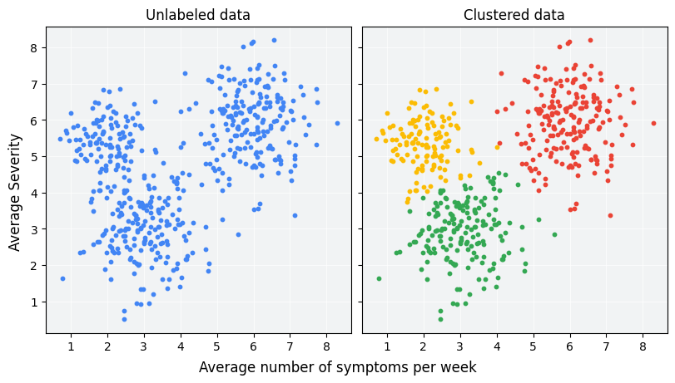
[Example] Clustering
Figure source: https://developers.google.com/machine-learning/clustering/overview?hl=zh-tw

Slide 6



[Example] Similarity Matching
以人臉辨識為例
資料庫
Similarity Matching
Valid or Invalid
我被掃描的照片

Slide 7

[Example] Dimensionality Reduction
以 AutoEncoder 為例
類似於近年的 self-supervised learning
Figure source: https://blog.keras.io/img/ae/autoencoder_schema.jpg

Slide 8
Regression

Slide 9
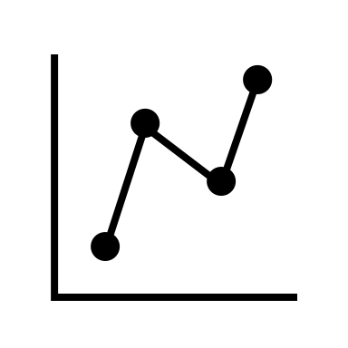
Regression Tasks (1)
Regression
Model
1100
2/17 | 2/18 | 2/19 | 2/20 | 2/21
1080 | 1085 | 1095 | 1080 | ?
Prediction based on the past data (Time-series)

Slide 10

Regression Tasks (2)
Regression
Model
15。C
2/17 | 2/18 | 2/19 | 2/20 | 2/21
15。C | 14。C | 13。C | 15。C | ?
Prediction based on the past data (Time-series)

Slide 11

Regression Tasks (3)
Regression
Model
1000
Area | City | Num of Rooms | House Age | Price
15 | Taoyuan | 3 | 10 | ?
Prediction based on the different features (Tabular data)

Slide 12
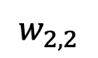
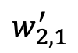
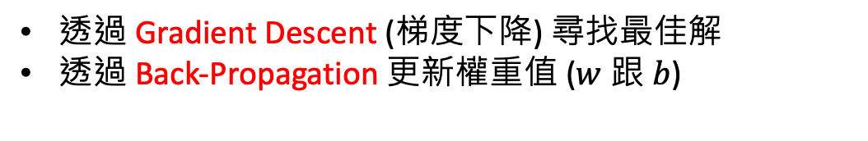
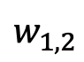
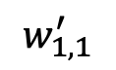
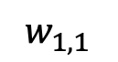
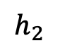
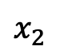
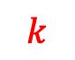
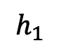
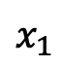
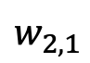
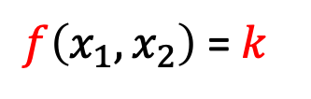
Machine Learning is to train a function
$$h_{1}$$
$$w_{1,1}$$
$$x_{1}$$
$$w_{1,1}^{′}$$
$$w_{1,2}$$
$$h_{2}$$
$$k$$
模型預測 (Predictions)
正確答案 (Ground-truths)
$$w_{2,1}$$
$$x_{2}$$
$$w_{2,1}^{′}$$
$f\left(x_{1},x_{2}\right)$ = $k$
$$w_{2,2}$$
透過 Gradient Descent (梯度下降) 尋找最佳解
透過 Back-Propagation 更新權重值 ($w$ 跟 $b$)
Back-Propagation 的結果

Slide 13

Training Process of a Deep Learning Model
深度學習模型被訓練的流程
Update weights (the learning part)
Model
Back-Propagation
Gradient Descent
Training Data
Calculate gradients

Slide 14
Gradient Descent vs. Back-propagation
 | Gradient Descent | Back-propagation
功能 | 根據梯度更新權重值 (weights) | 計算神經網路中的梯度，以供梯度下降使用
最終目標 | 透過梯度找出 function 最佳解 (最小化目標函數) | 計算梯度，以便使用梯度下降找到最佳解

Slide 15
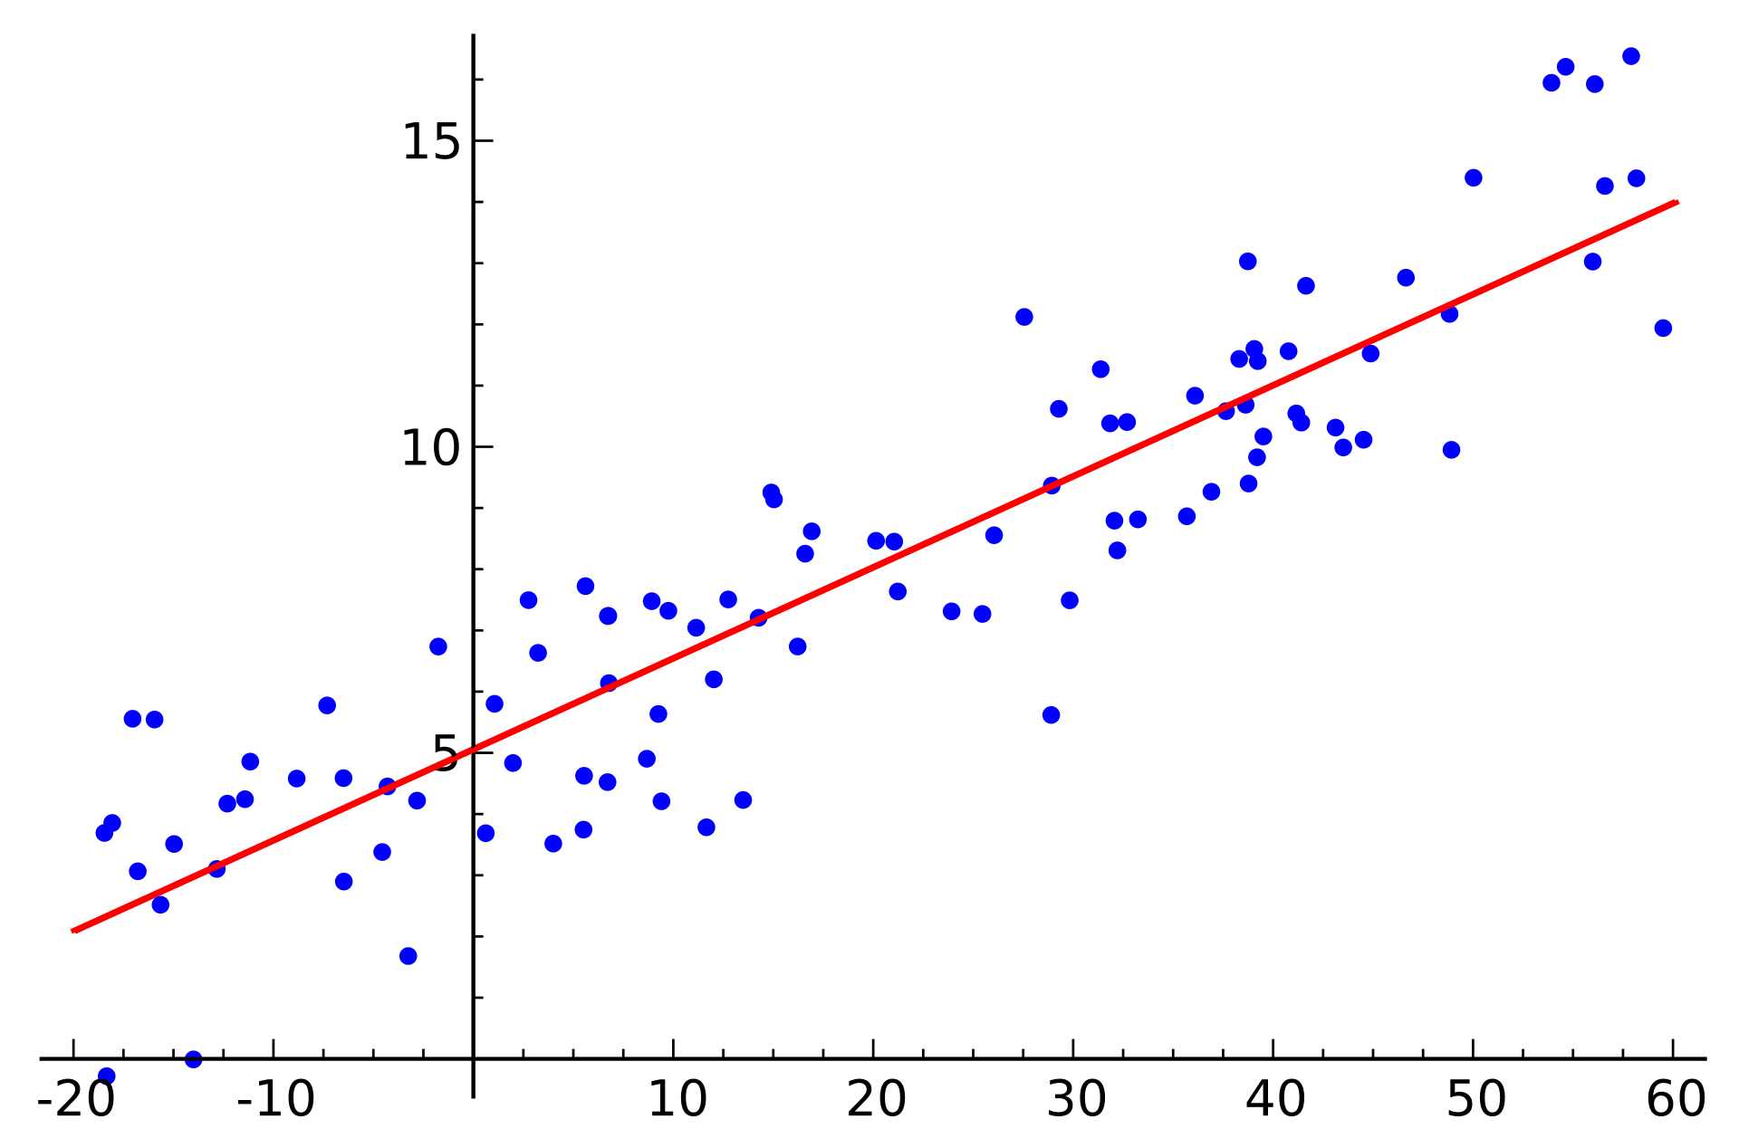
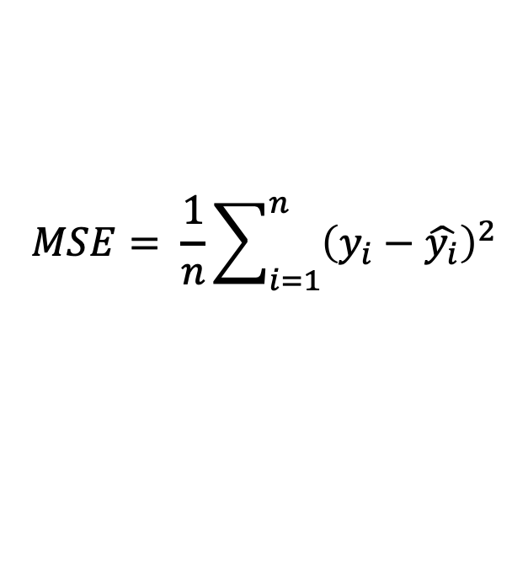
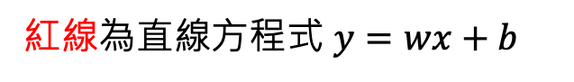
Linear Regression (線性迴歸)
紅線為直線方程式 $y=wx+b$
Linear regression 通常透過均方誤差來擬合資料
$$MSE= \frac{1}{n}\sum_{i=1}^{n}{{\left(y_{i}−\hat{y_{i}}\right)}^{2}}$$
紅線代表可以使所有藍色點的MSE最小的w跟b代入直線方程式後得到的線
https://zh.wikipedia.org/zh-tw/迴歸分析

Slide 16
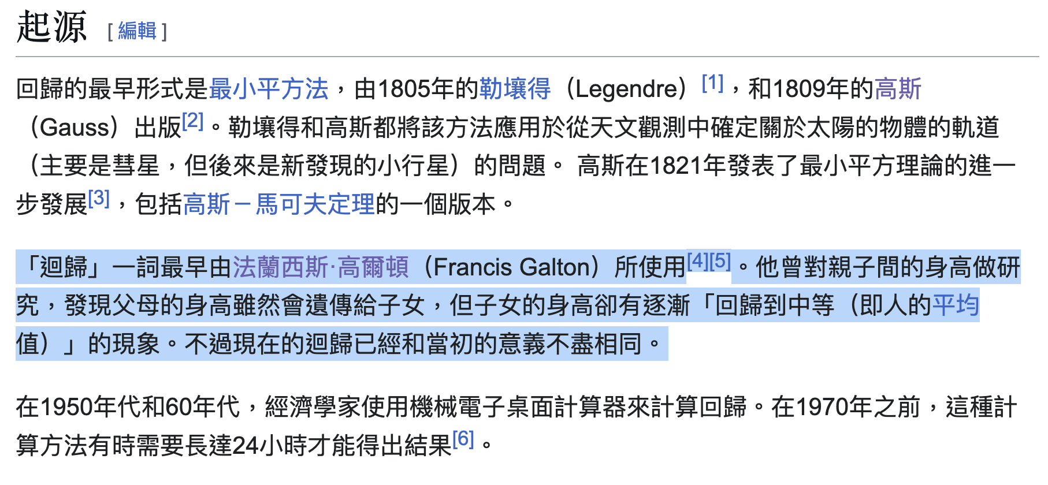
為什麼Regression叫做Regression？
https://zh.wikipedia.org/zh-tw/迴歸分析
https://stats.stackexchange.com/questions/11087/why-are-regression-problems-called-regression-problems

Slide 17
Math Warning!!

Slide 18
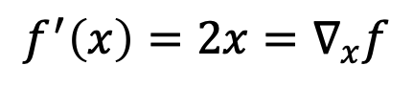
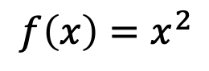
What are gradients? (數學定義)
First-order derivative (s)
Univariate function: a scaler
Multivariate function: a vector
Univariate Example:
Original function:
$$f\left(x\right)=x^{2}$$
First-order derivative:
$$f^{′}\left(x\right)=2x=∇_{x}f$$

Slide 19
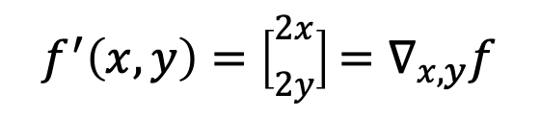
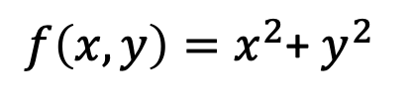
What are gradients? (數學定義)
First-order derivative (s)
Univariate function: a scaler
Multivariate function: a vector
Multivariate Example:
Original function:
$f\left(x, y\right)=x^{2}$+ $y^{2}$
$$f^{′}\left(x,y\right)=\left[\begin{matrix}2x \\ 2y\end{matrix}\right]=∇_{x,y}f$$
First-order derivatives:

Slide 20
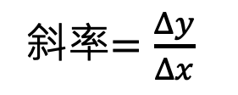
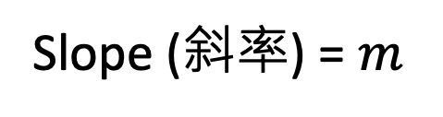
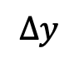
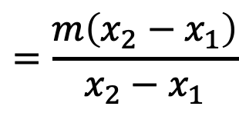
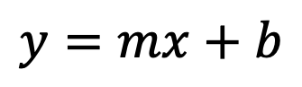
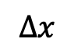
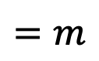
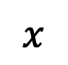
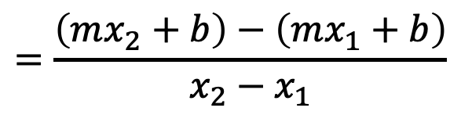
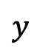
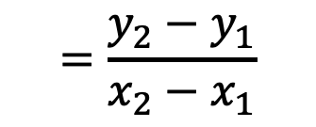
What are gradients? (數學意義)
$$y=mx+b$$
$$y$$
斜率$=\frac{Δy}{Δx}$
Slope (斜率) = $m$
$$=\frac{y_{2}−y_{1}}{x_{2}−x_{1}}$$
$$Δy$$
$$=\frac{\left(mx_{2}+b\right)−\left(mx_{1}+b\right)}{x_{2}−x_{1}}$$
$$Δx$$
$$=\frac{m\left(x_{2}−x_{1}\right)}{x_{2}−x_{1}}$$
$$x$$
$$=m$$

Slide 21
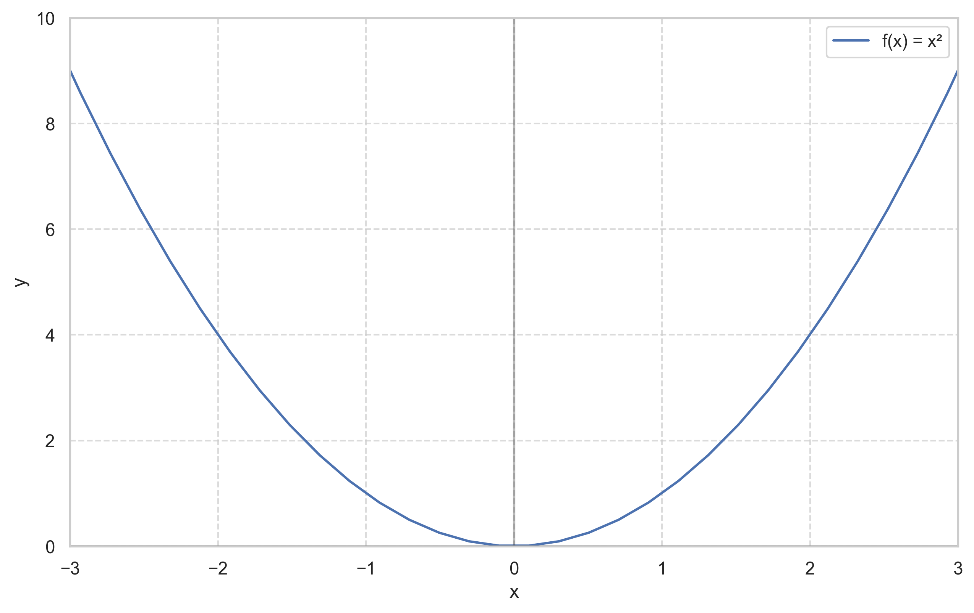
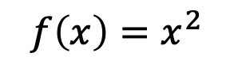
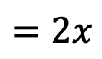
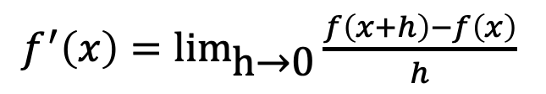
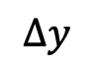
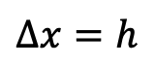
What are gradients? (數學意義)
斜率$=\frac{Δy}{Δx}$
$$f\left(x\right)=x^{2}$$
一次導函數：
$f^{′}\left(x\right)=\text{li}{\text{m}}_{\text{h}\text{→}\text{0}}\frac{f\left(x+h\right)−f\left(x\right)}{h}$
$$Δy$$
$$=2x$$
$$Δx=h$$
梯度等於一次導函數的值，也就是斜率

Slide 22
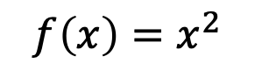
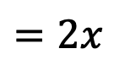
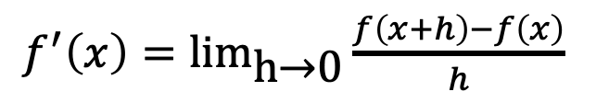
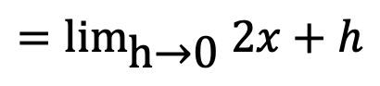
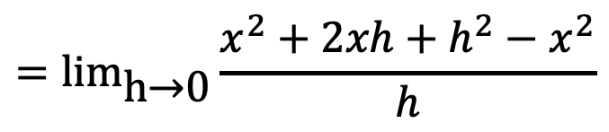
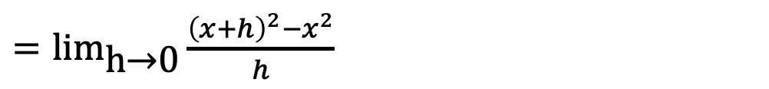
計算導數
$$f\left(x\right)=x^{2}$$
$f^{′}\left(x\right)=\text{li}{\text{m}}_{\text{h}\text{→}\text{0}}\frac{f\left(x+h\right)−f\left(x\right)}{h}$
$=\text{li}{\text{m}}_{\text{h}\text{→}\text{0}}\frac{{\left(x+h\right)}^{2}−x^{2}}{h}$
$$=\text{li}{\text{m}}_{\text{h}\text{→}\text{0}}\frac{x^{2}+2xh+h^{2}−x^{2}}{h}$$
$$=\text{li}{\text{m}}_{\text{h}\text{→}\text{0}} 2x+h$$
$$=2x$$
(h 趨近於 0)
謝謝陳冠甫老師找出公式錯誤

Slide 23
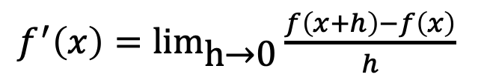
What are gradients? (物理意義)
$f^{′}\left(x\right)=\text{li}{\text{m}}_{\text{h}\text{→}\text{0}}\frac{f\left(x+h\right)−f\left(x\right)}{h}$
有一跑者10分鐘內跑了2km，請問這個人一秒鐘跑多少公里？
速度 = 距離 / 時間
一秒鐘可以被想成h趨近於0
因此，梯度代表在極短情況 (這裡用時間舉例) 的變化量

Slide 24
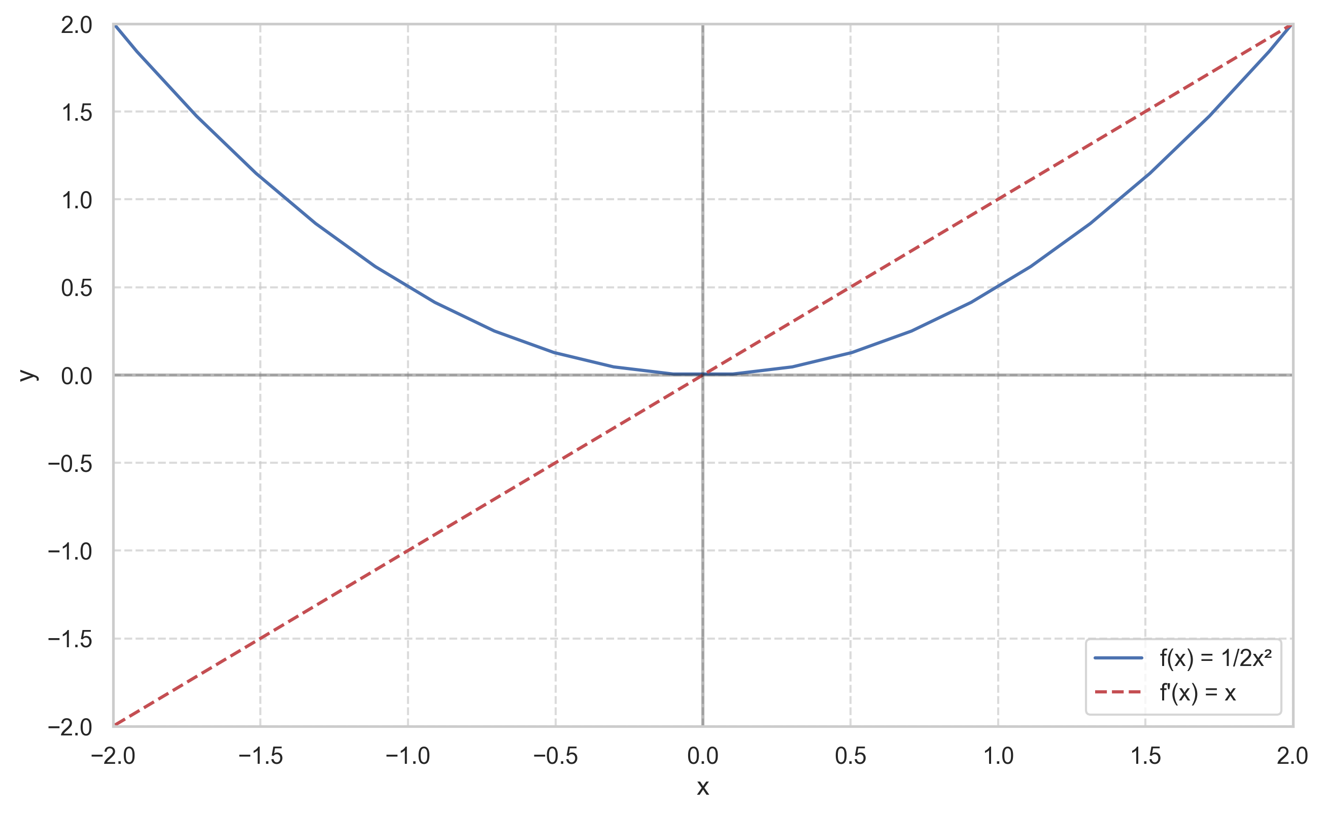
Gradient Descent
一次導數為零達到最佳解

Slide 25
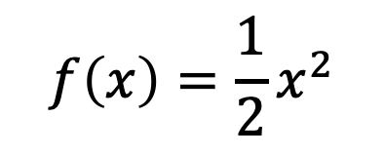
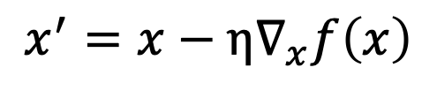


Gradient Descent (梯度下降法)
Assume $x$ is a trainable parameter (weight), $f$is a differentiable function:
Gradient descent:
$$x^{′}=x−η∇_{x}f\left(x\right)$$
Objective function
(example):
$$f\left(x\right)=\frac{1}{2}x^{2}$$
$η$ is the learning rate used for gradient descent.

Slide 26




What “Function” we‘re going to train?
Loss Function
以均方誤差 (Mean Squared Error) 為例：
$$MSE= \frac{1}{n}\sum_{i=1}^{n}{{\left(y_{i}−\hat{y_{i}}\right)}^{2}}$$
$$=\frac{1}{n}\sum_{i=1}^{n}{{\left(y_{i}−\left(wx_{i}+b\right)\right)}^{2}}$$
我們要訓練的 function
其中:
$n$ 代表有 $n$ 筆訓練資料
$y_{i}$ 爲任一筆 ground-truth、$\hat{y_{i}}$ 爲任一筆 prediction (model output)
假設模型的輸出是 $wx_{i}+b$

Slide 27





以兩個點來觀察 Gradient Descent 的特性
$$x^{′}=x−η∇_{x}f\left(x\right)$$
梯度 $∇_{x}f\left(x\right)<$ 0
梯度 $∇_{x}f\left(x\right)$> 0
$x$ 會變大
$x$ 會變小

Slide 28
為什麼可以用位置減梯度？(1/3)
梯度主要是提供參數要修正的「方向」
正號或負號
讓參數的值改變最後順利走到最低點

Slide 29
為什麼可以用位置減梯度？(2/3)
如果|梯度|很大的話，表示該位置還在非常陡峭的位置，通常在這時候參數的值確實需要改變多一點

Slide 30
為什麼可以用位置減梯度？(3/3)
如果|梯度|很小的話，表示該位置在函數平滑的位置，通常在這時候參數的值可能需要改變少一點

Slide 31
Gradient Descent 流程推導

Slide 32



Minimize a Regression Model
以均方誤差 (Mean Squared Error) 為例：
$$ℒ= \frac{1}{n}\sum_{i=1}^{n}{{\left(y_{i}−\hat{y_{i}}\right)}^{2}}$$
$$=\frac{1}{n}\sum_{i=1}^{n}{{\left(y_{i}−\left(wx_{i}+b\right)\right)}^{2}}$$
其中:
$ℒ$ 代表 Loss function；$n$ 代表有 $n$ 筆訓練資料
$y_{i}$ 爲任一筆 ground-truth、$\hat{y_{i}}$ 爲任一筆 prediction (model output)

Slide 33



Minimize a Regression Model
$$ℒ=\frac{1}{n}\sum_{i=1}^{n}{{\left(y_{i}−\left(wx_{i}+b\right)\right)}^{2}}$$
$$\frac{∂ℒ}{∂w}=\frac{1}{n}\sum_{i=1}^{n}{2\left(y_{i}−\left(wx_{i}+b\right)\right)}⋅\left(−x_{i}\right)$$
對w進行偏微分
$$\frac{∂ℒ}{∂b}=\frac{1}{n}\sum_{i=1}^{n}{2\left(y_{i}−\left(wx_{i}+b\right)\right)}⋅\left(−1\right)$$
對b進行偏微分

Slide 34





The generalized power rule for derivatives
Assume $y={\left[u\left(x\right)\right]}^{n}$
, and $u\left(x\right)$ is differentiable.
$$\frac{dy}{dx}=n⋅{\left[u\left(x\right)\right]}^{n−1}⋅u^{′}\left(x\right)$$
Then
$$\frac{∂ℒ}{∂w}=\frac{1}{n}\sum_{i=1}^{n}{2\left(y_{i}−\left(wx_{i}+b\right)\right)}⋅\left(−x_{i}\right)$$
$$\frac{∂ℒ}{∂b}=\frac{1}{n}\sum_{i=1}^{n}{2\left(y_{i}−\left(wx_{i}+b\right)\right)}⋅\left(−1\right)$$
證明： http://www.math.ncu.edu.tw/~yu/ecocal95/boards/lec12_c_95.pdf (from 中央大學數學系)

Slide 35




Minimize a Regression Model
$$\frac{∂ℒ}{∂w}=\frac{1}{n}\sum_{i=1}^{n}{2\left(y_{i}−\left(wx_{i}+b\right)\right)}⋅\left(−x_{i}\right)$$
$$\frac{∂ℒ}{∂b}=\frac{1}{n}\sum_{i=1}^{n}{2\left(y_{i}−\left(wx_{i}+b\right)\right)}⋅\left(−1\right)$$
更新w：
更新b：
$$w_{t}=w_{t−1}−η\frac{∂ℒ}{∂w_{t−1}}$$
$$b_{t}=b_{t−1}−η\frac{∂ℒ}{∂b_{t−1}}$$
$η$ 代表 learning rate，扮演梯度下降過程的重要角色

Slide 36

The impact of a Learning Rate
Figure source: https://www.jeremyjordan.me/nn-learning-rate/

Slide 37


How to choose the best learning rate?
Figure source: https://x.com/karpathy/status/801621764144971776

Slide 38
More resources for Calculus
https://calcgospel.top/wp-content/uploads/2020/06/02-01-微分的定義.pdf

Slide 39
More resources for gradient descent
Deep Learning Book Chapter 4.3: Gradient-Based Optimization
https://www.deeplearningbook.org/contents/numerical.html
https://www.youtube.com/watch?v=fegAeph9UaA
https://speech.ee.ntu.edu.tw/~tlkagk/courses/ML_2016/Lecture/Regression%20(v6).pdf

Slide 40

PyTorch Tutorial
Figure source: https://pytorch.org/

Slide 41
Thank you!
Instructor: 林英嘉
✉️ yjlin@cgu.edu.tw
TA: 林君襄
✉️ becky890926@gmail.com

